Slide 1
RGB lab updates
Xavier Braun

Slide 2
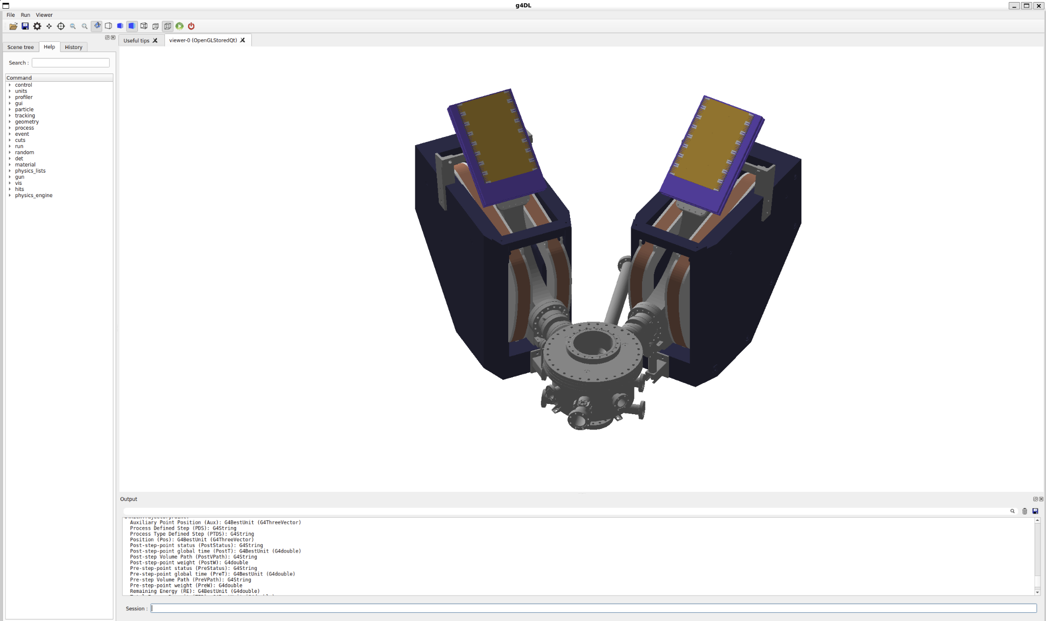
Finally got g4DL simulation to work (thank you Win)

Slide 3
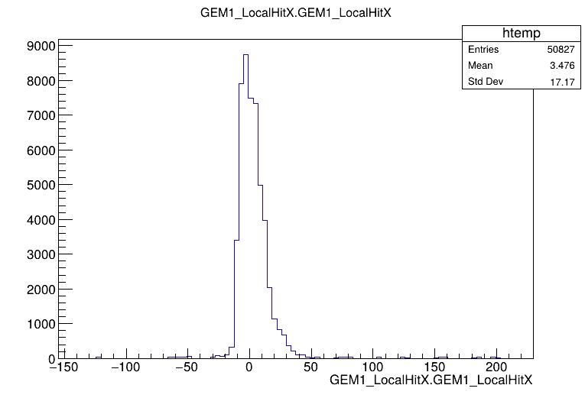
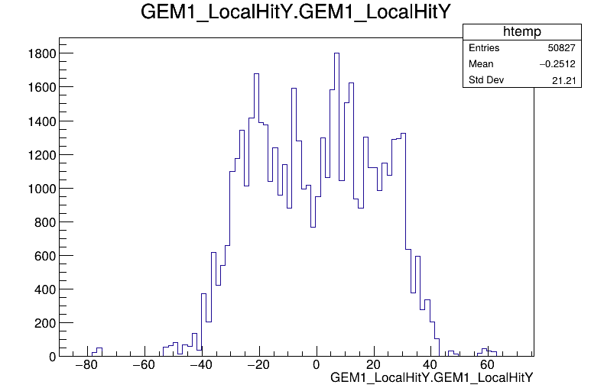
First set of simulated data produced, changed the run2.mac file (and figured out how to use the root object browser)

Slide 4
Next steps
Get used to root, generate data for a basic gaussian distribution and fit it in root
Familiarize myself with C++
Work on the “readout” material change to carbon fiber, read the “Construction, test and commissioning of the triple-gem tracking detector for compass” paper

Slide 5
RGB lab updates 11/1
Xavier Braun

Slide 6
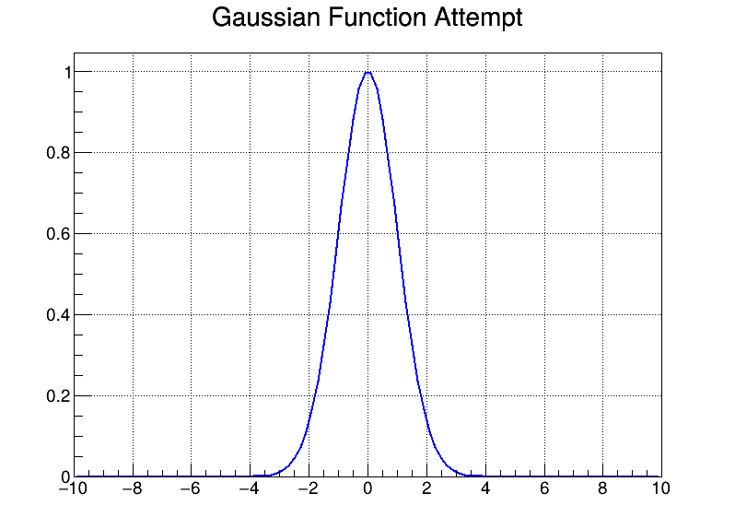
First Gaussian distribution I made with root, with an amplitude of 1, a sigma of 1 and and mean value of 0, to see if I can use TCanvas and TF1 to create a basic gaussian

Slide 7
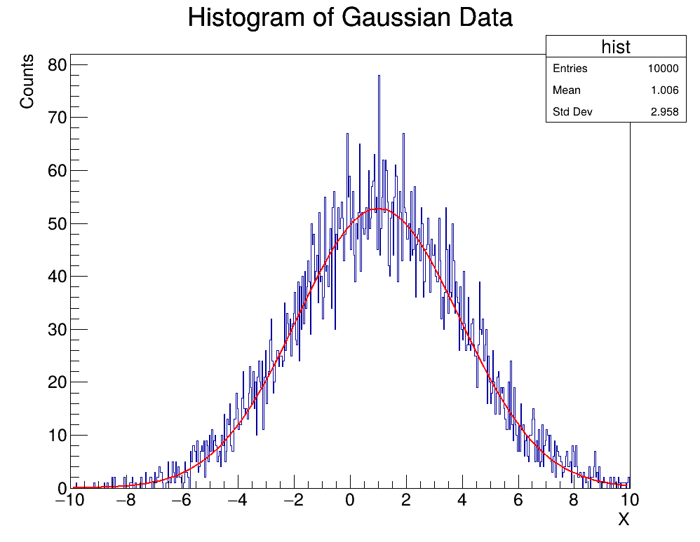
Created a random gaussian distribution, which was then fitted alongside a printed standard deviation and mean using root (the given values were 3 and 1 for stdv and mean respectively).
(also found a website called Learn C++ which has been helping tremendously).

Slide 8
Next steps
Finished reading the Gem Construction paper
Currently reading through the geant4 geometry page to get an idea of what to do
Actually work on the gem construction code, requires overlapping copper strips and carbon fiber for the readout layer
Still trying to decipher the current code

Slide 9
RGB lab updates 11/11
Xavier Braun

Slide 10
Working on the Copper Strip and Overlap layers
After a brief discussion yesterday, I have changed the functions to space the strips out according to the size of the detector and width of the strips, not based on spacing between strips
Have also defined another gem layer for the overlapping regions between the two layers to create a plaid pattern
I have a small issue related to the g4PSIGEM.hh file which needs to be adjusted due to the new functions being called (didn’t know this until today), once that is done I can look at the resultant simulation!

Slide 11
RGB lab updates 11/21
Xavier Braun

Slide 12
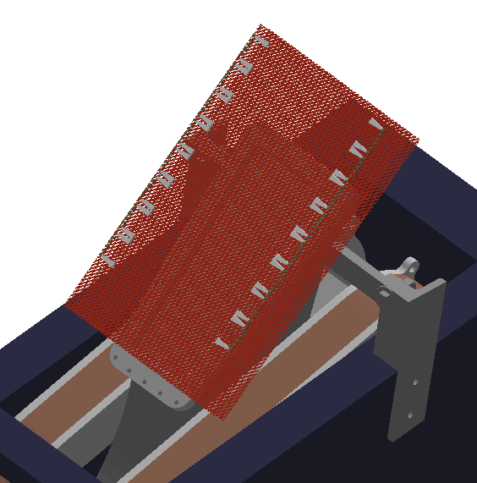
Got the two layers of strips working!
Still working on the overlap area in between the strip layers.
Next step(s) are to make individual sheets with strips removed, as opposed to making individual strips, but should be easier now with an idea of what to do.

Slide 13
RGB lab updates 12/1
Xavier Braun

Slide 14
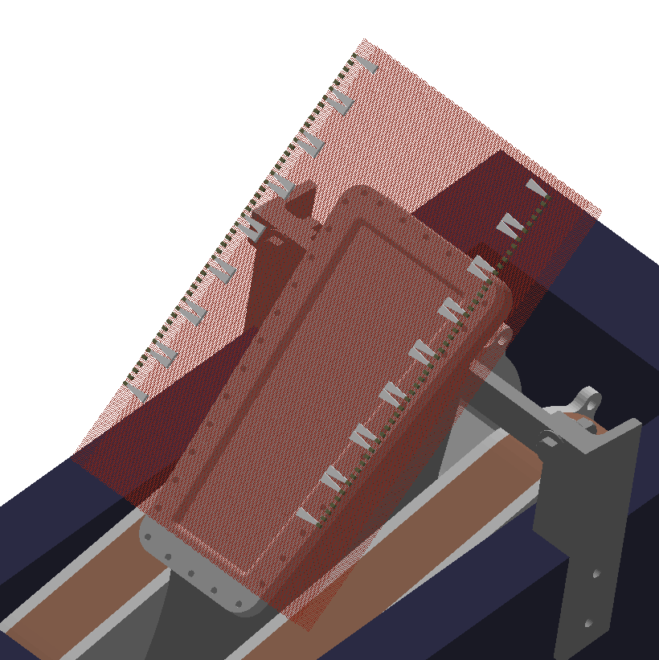
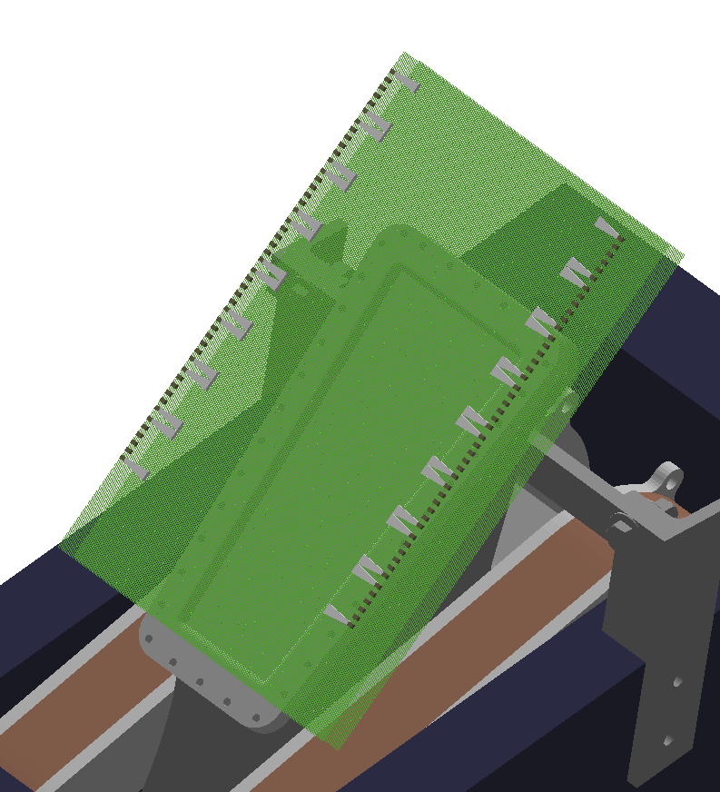
Visualization may look slightly off: This comes as a result of the thinness of the copper strips (80 and 340 micron) and the number of strips.
X Direction Strips
Y Direction Strips

Slide 15
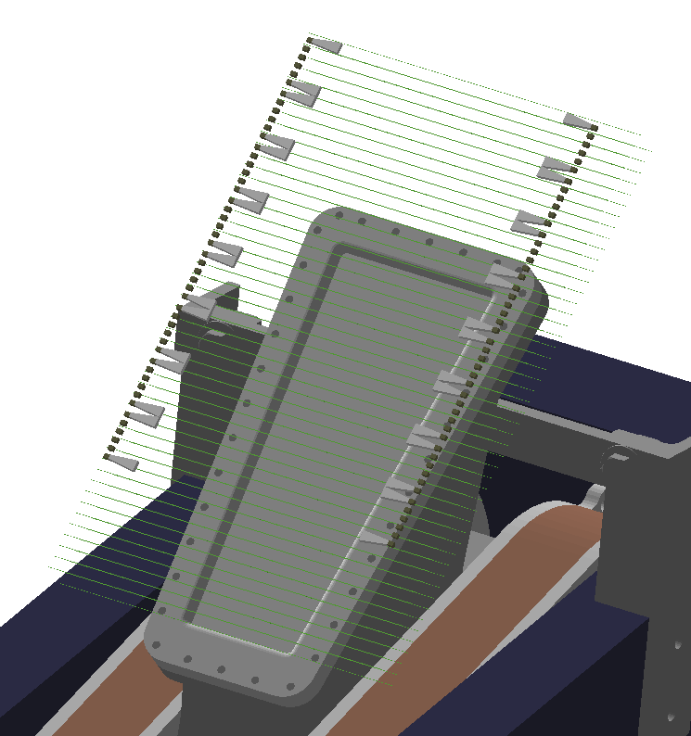
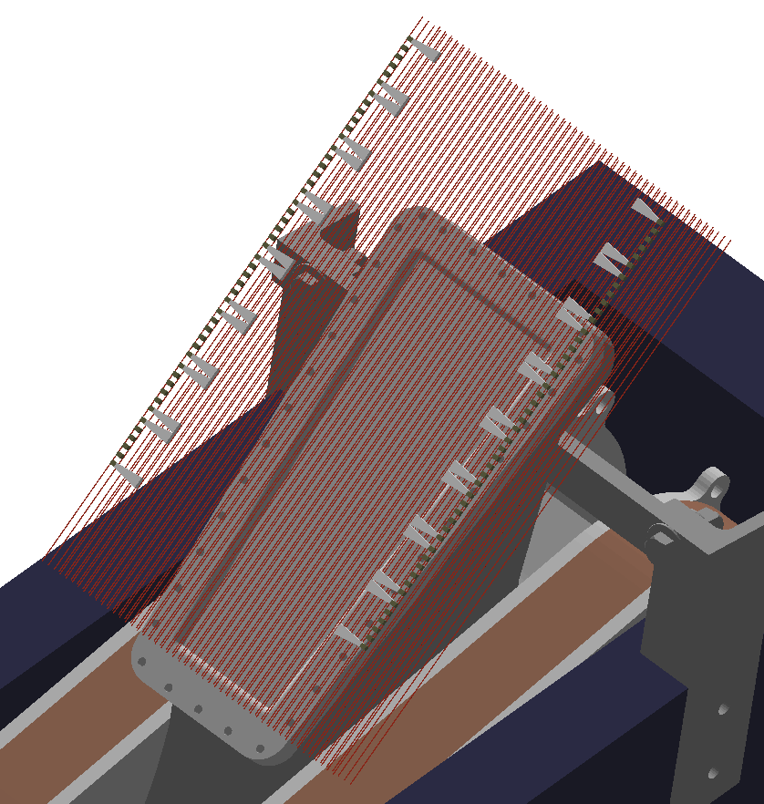
For Visibility

Slide 16
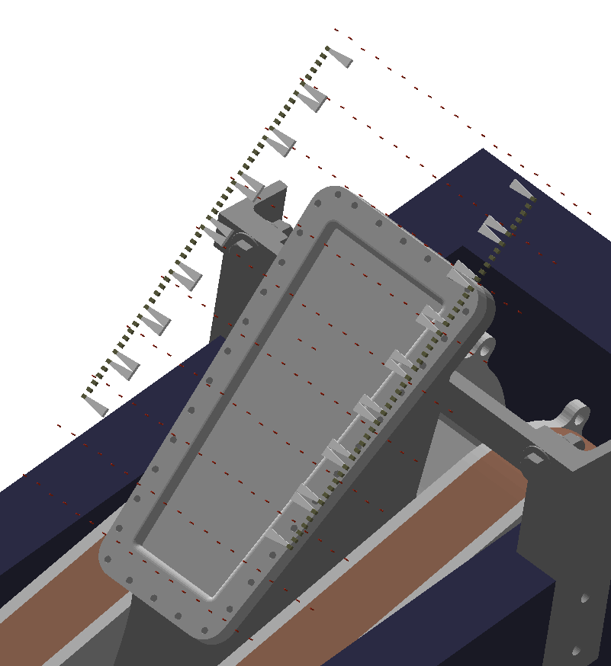
Kapton ridges

Slide 17
RGB lab updates 1/27
Xavier Braun

Slide 18
Previous semester work
I was working on translating the COMPASS gem readout board code to the darklight simulation.
These included the x and y direction copper strips and the kapton spacers in between each of these strips.
The individual strips/spacers slow the simulation down to a pitch drop experiment speed even when treated as a single volume

Slide 19
(Temporary) Solution
Treat each of the new layers the same as the gem layers (no individual copper strips/kapton ridges) Layers are: - Copper (0.2) - Kapton(0.2) - Copper(0.85) - Fiberglass
More permanent solution: - Adjust the layer density as though it still has those gaps
- (Any other suggestions welcome)

Slide 20
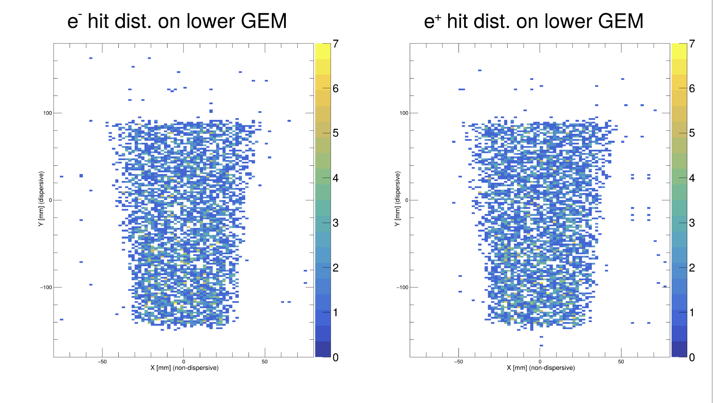
Hits with new readout board

Slide 21
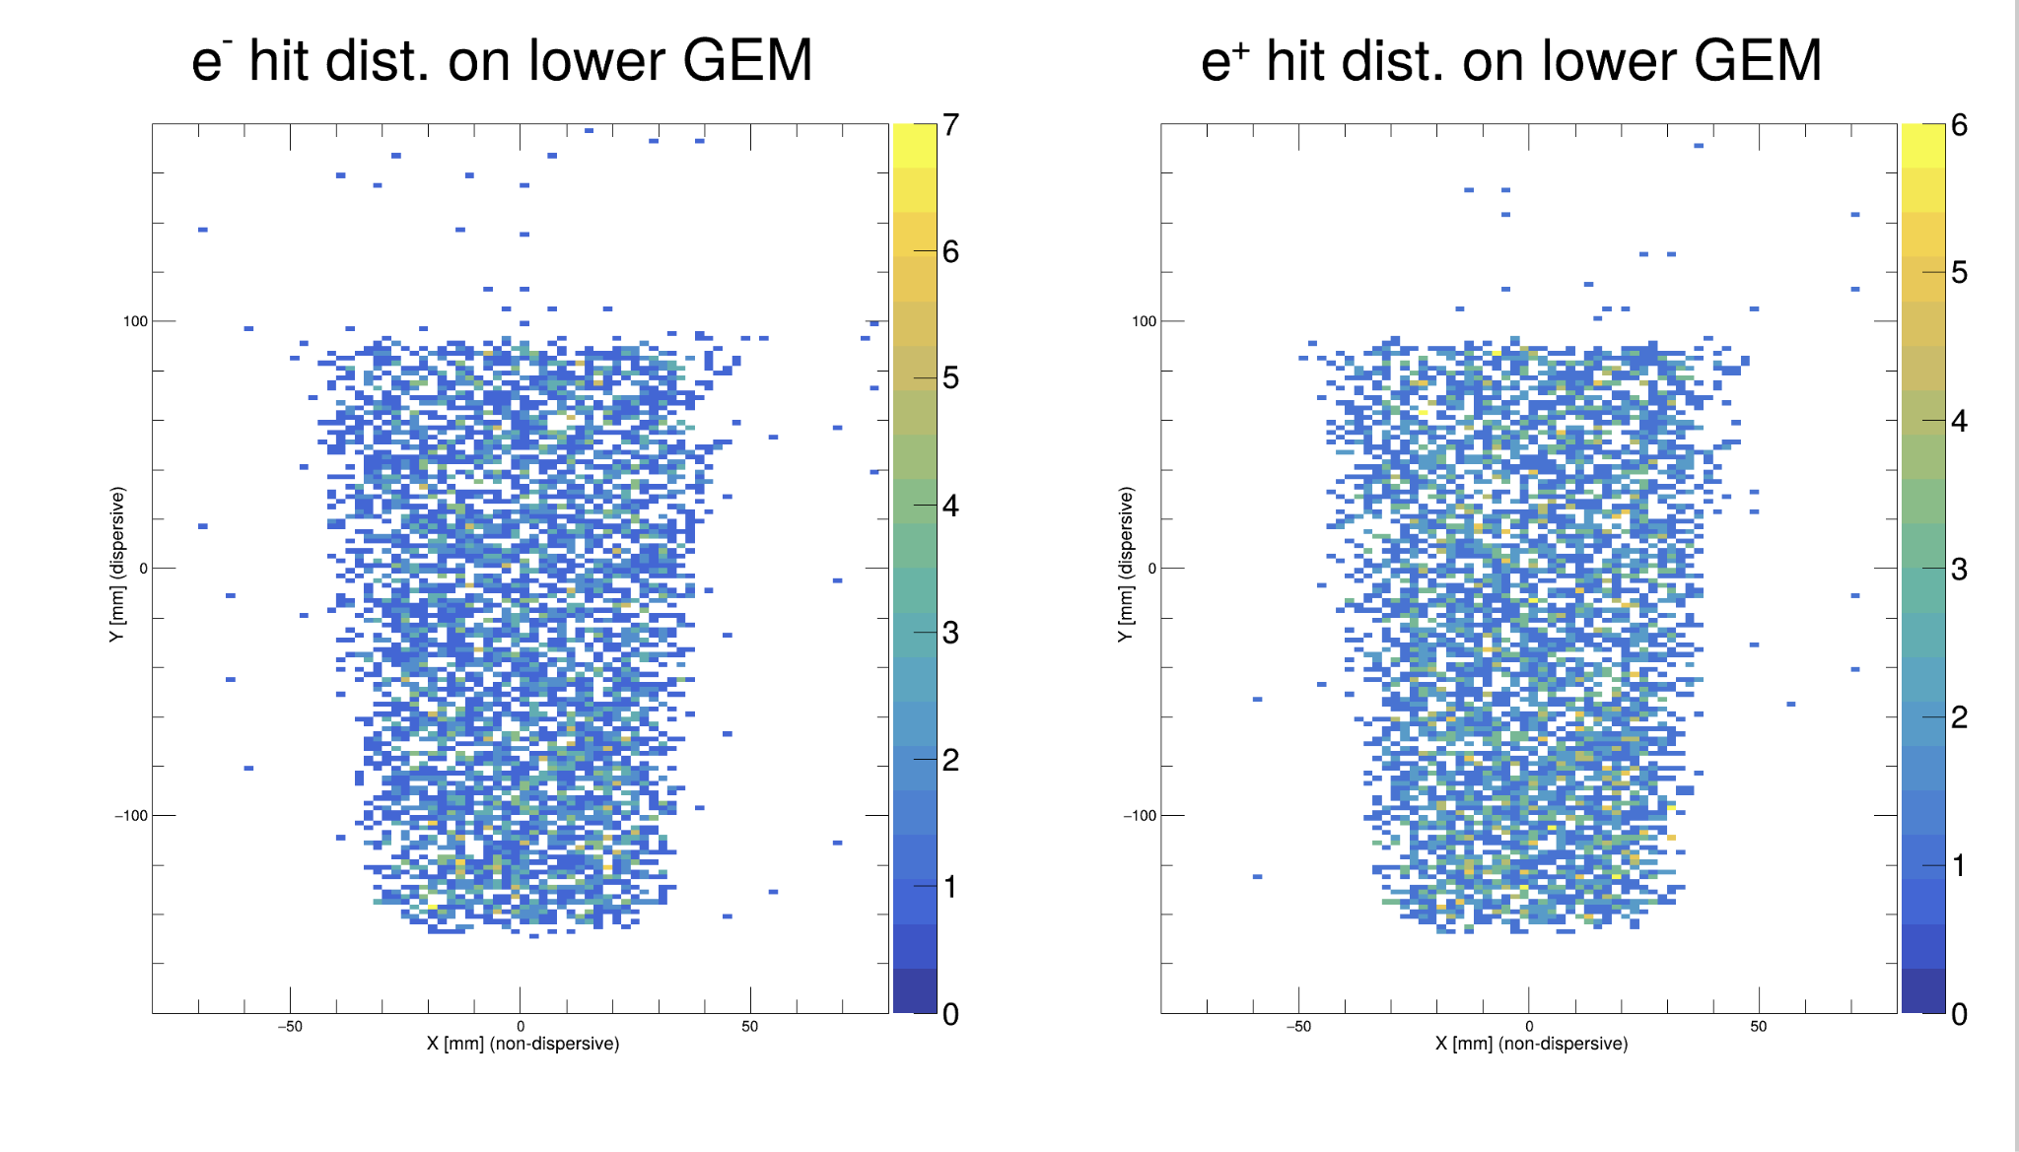
Hits with old readout board

Slide 22
RGB lab updates 2/3
Xavier Braun

Slide 23
Context: New Readout Board
I am replacing the MUSE readout board with the version based on COMPASS design
Treat each of the new layers the same as the gem layers (no individual copper strips/kapton ridges) Layers are: - Copper (0.2) - Kapton(0.2) - Copper(0.85) - Fiberglass
Previous semester attempted to have individual kapton spacers/copper strips but slowed the simulation down heavily

Slide 24
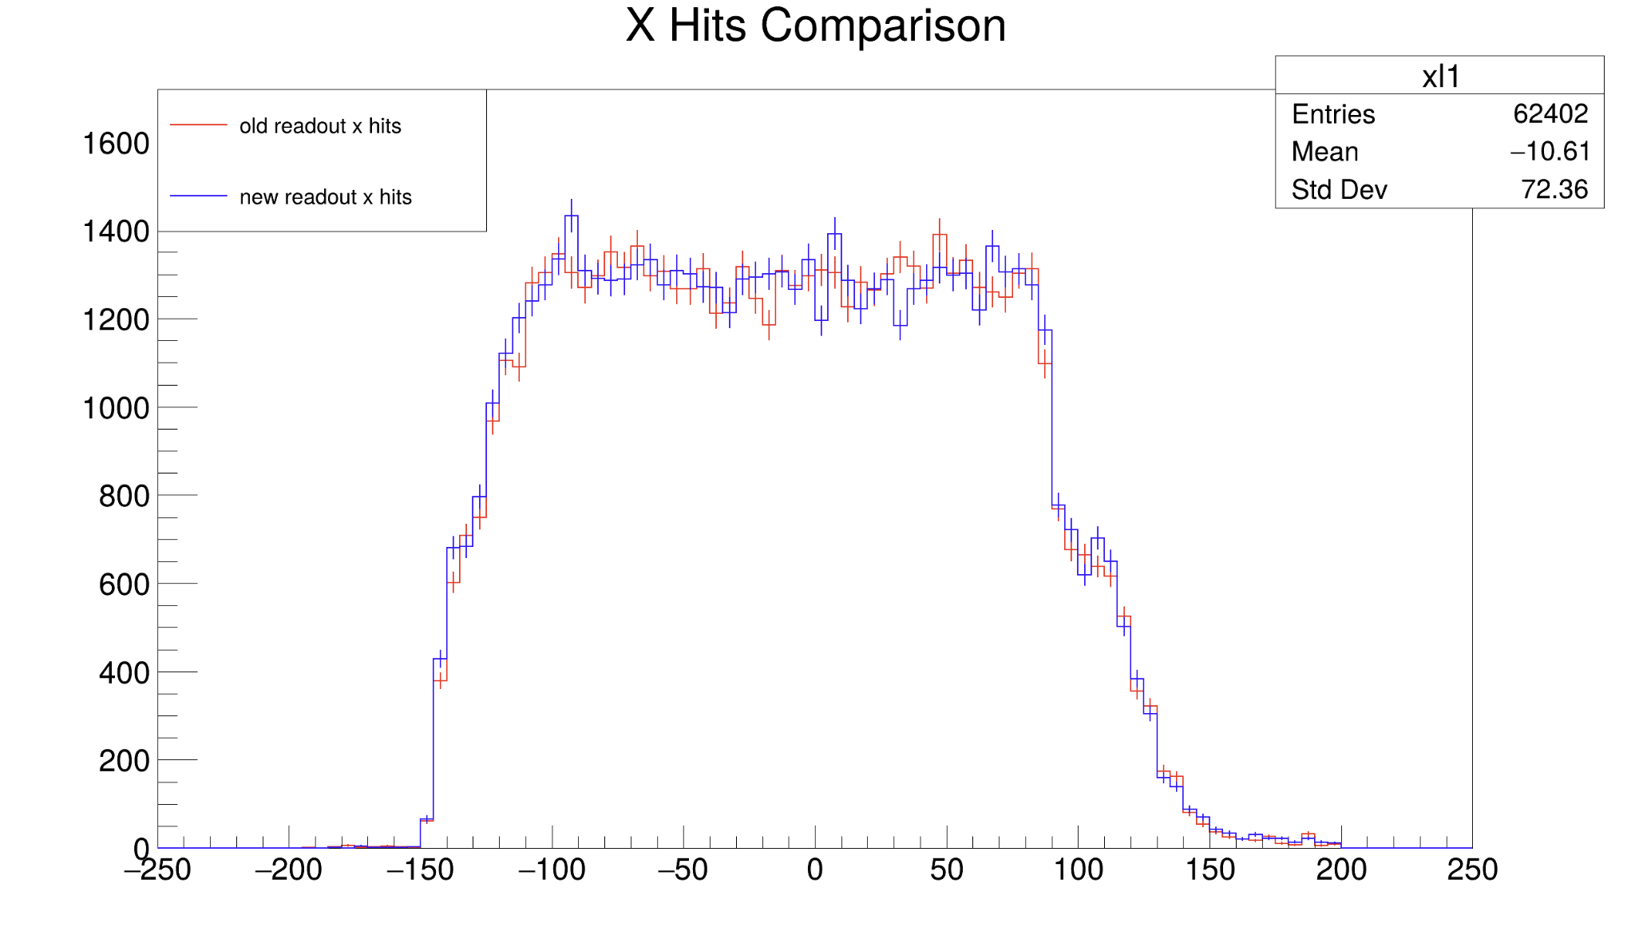
X Hits Comparison, 1D Plot, 15000 events
Run with random gun mode
error is sqrt(n)

Slide 25
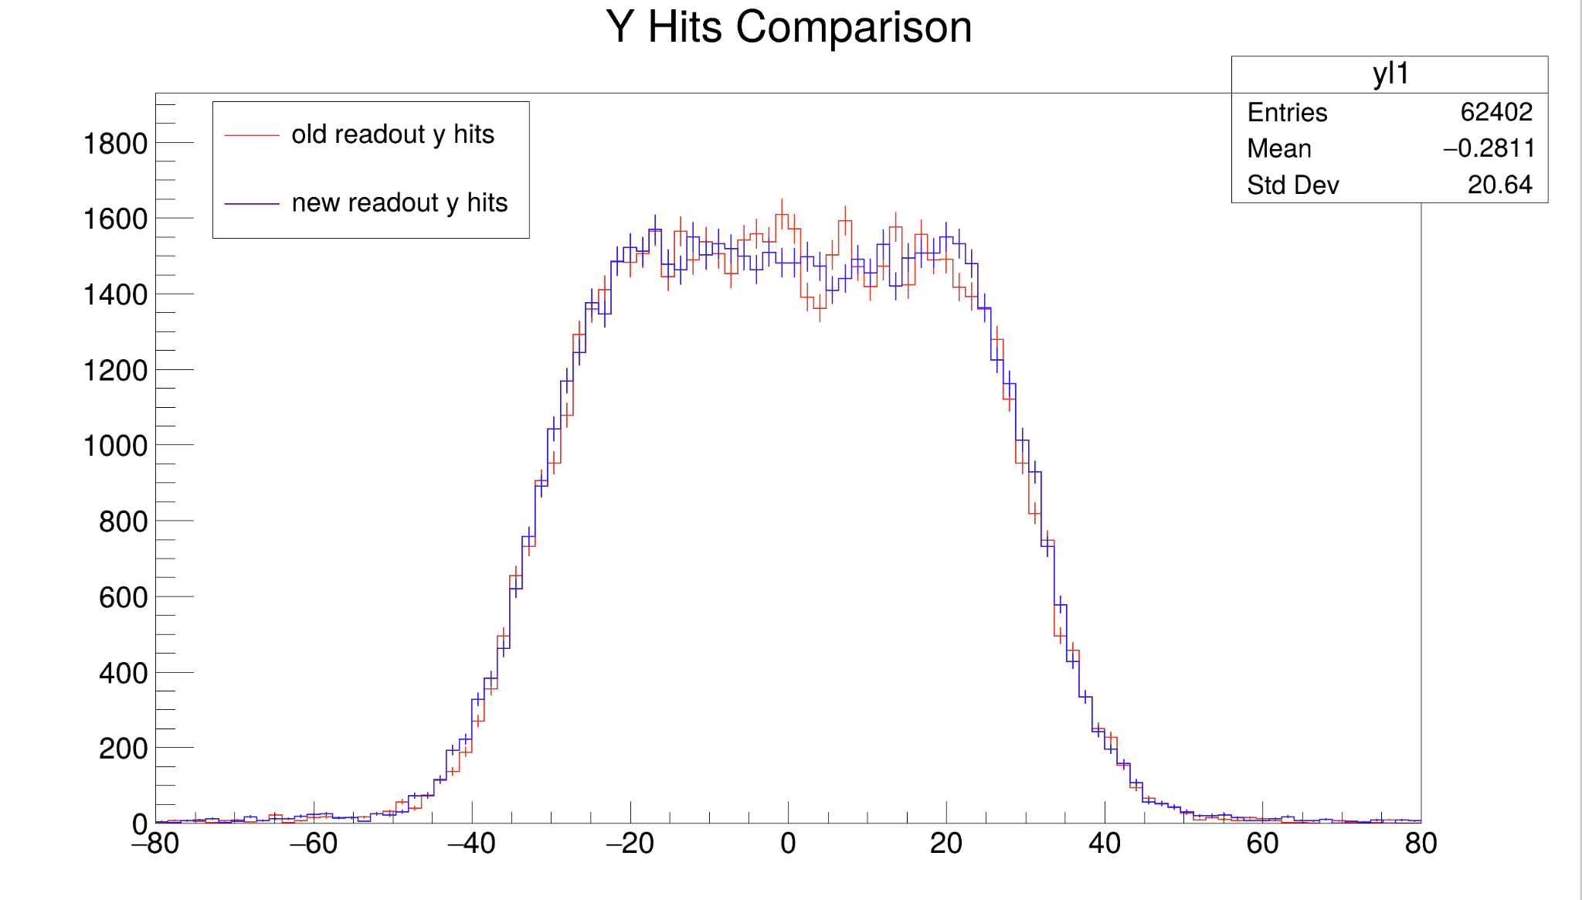
Y Hits Comparison , 1D Plot, 15000 events
Run with random gun mode
error is sqrt(n)

Slide 26
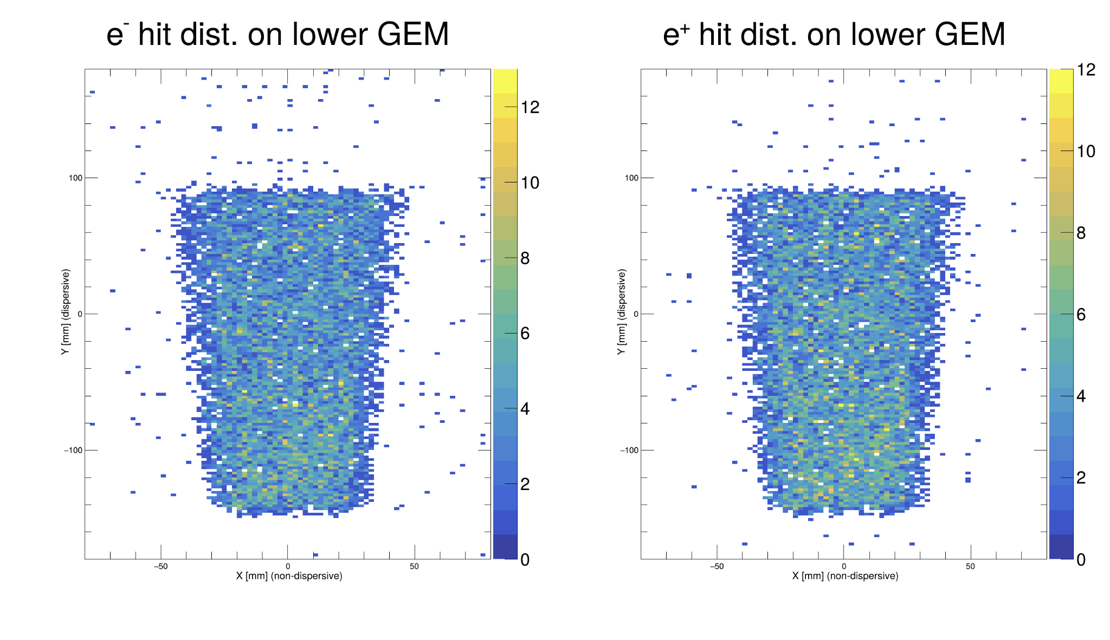
Hits with old readout board, 2D Plots, 15000 events
Run with random gun mode

Slide 27
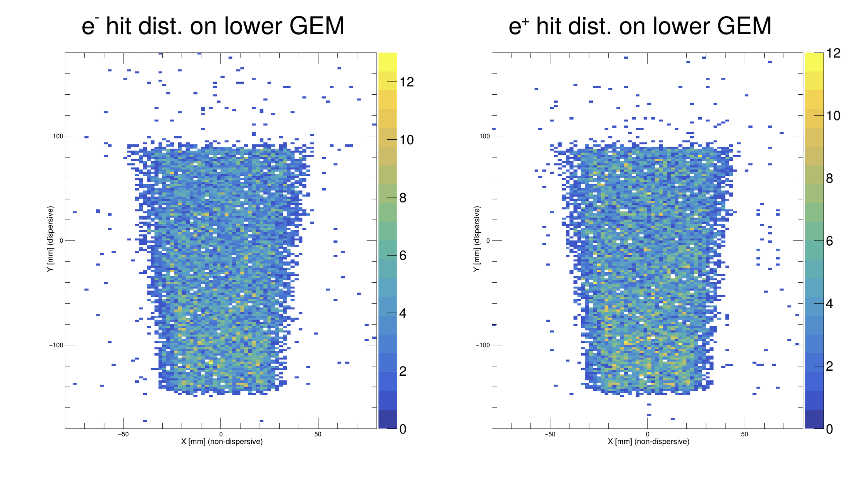
Hits with new readout board, 2D Plots, 15000 events
Run with random gun mode

Slide 28
Next Steps
Looking to retry the copper strip/kapton spacer layers in a way which doesn’t slow down the event interactions
G4PVReplica/Division may be fruitful
Rerun the tests to see how they affect the hits in 1D and 2D

